Slide 1


Getting Started with OpenTelemetry in .NET
Frank Boucher – Cloud Advocacy - Microsoft
Jason Hand – SRE/DevOps/AI Advocacy - Datadog
Frank Boucher
Jason Hand
Cloud Advocacy – Microsoft Azure
DevOps/SRE/AI Advocacy - Datadog

Slide 2

Getting Started with OpenTelemetry in .NET
Frank Boucher
Jason Hand
Cloud Advocacy – Microsoft Azure
DevOps/SRE/AI Advocacy - Datadog

Slide 3
What is OpenTelemetry?
OpenTelemetry (OTel) is an open source, vendor-neutral observability framework for instrumenting, collecting, and exporting telemetry data such as metrics, traces, logs, and profiling
OpenTelemetry is NOT a monitoring/observability platform
Note: OpenTracing and OpenCensus merged into OpenTelemetry
Notes:
OpenTelemetry (OTel) is a toolset and standard for collecting telemetry data such as metrics, traces, and logs.

Slide 4
What is OpenTelemetry?
Collection of APIs and SDKs
Semantic Conventions
Tools

Slide 5
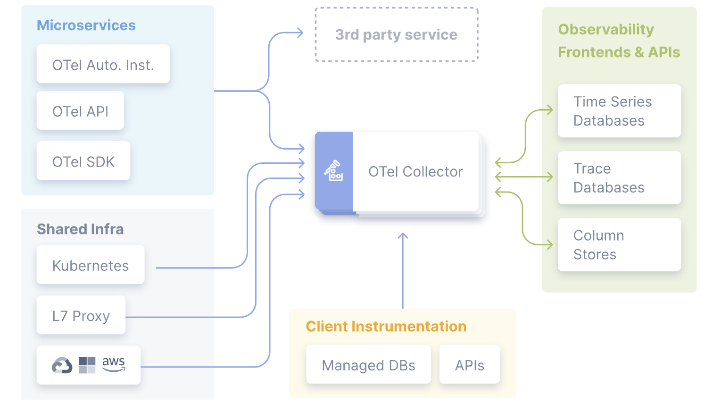
OpenTelemetry Components
OTLP protocol
Semantic conventions
OpenTelemetry APIs
Language SDKs
OpenTelemetry Collector
A library ecosystem
OpenTelemetry Operator for Kubernetes, OpenTelemetry Helm Charts, and community assets for FaaS
Notes:
OTLP protocol - standard that defines the shape of telemetry data
Semantic conventions - define a standard naming scheme for common telemetry data types
OpenTelemetry APIs - define how to generate telemetry data
Language SDKs - implement the specification, APIs, and export of telemetry data
The OpenTelemetry Collector - a proxy that receives, processes, and exports telemetry data
A library ecosystem - implements instrumentation for common libraries and frameworks
Other Tools -e.g. OpenTelemetry Operator for Kubernetes, OpenTelemetry Helm Charts, and community assets for FaaS

Slide 6
OpenTelemetry Collector Pipeline
Receivers
Processors
Receive traces from your Java application using the OTel Java SDK as well as Prometheus
Use a processor to filter out sensitive data
Exporters
Connectors
Export the telemetry data to both Datadog and another vendor for visualization and analysis
Connect traces to metrics for additional performance insights
Notes:
Receivers collect telemetry data from various sources, such as agents, instrumentation libraries, and other collectors.
Processors transform, filter, and enrich telemetry data. They can add attributes, remove sensitive data, or aggregate data.
Exporters send telemetry data to backend systems such as Datadog, Prometheus, or Jaeger.
Connectors let a pipeline send its telemetry to another. For example, the traces pipeline can use a connector to send data to the metrics pipeline.

Slide 7
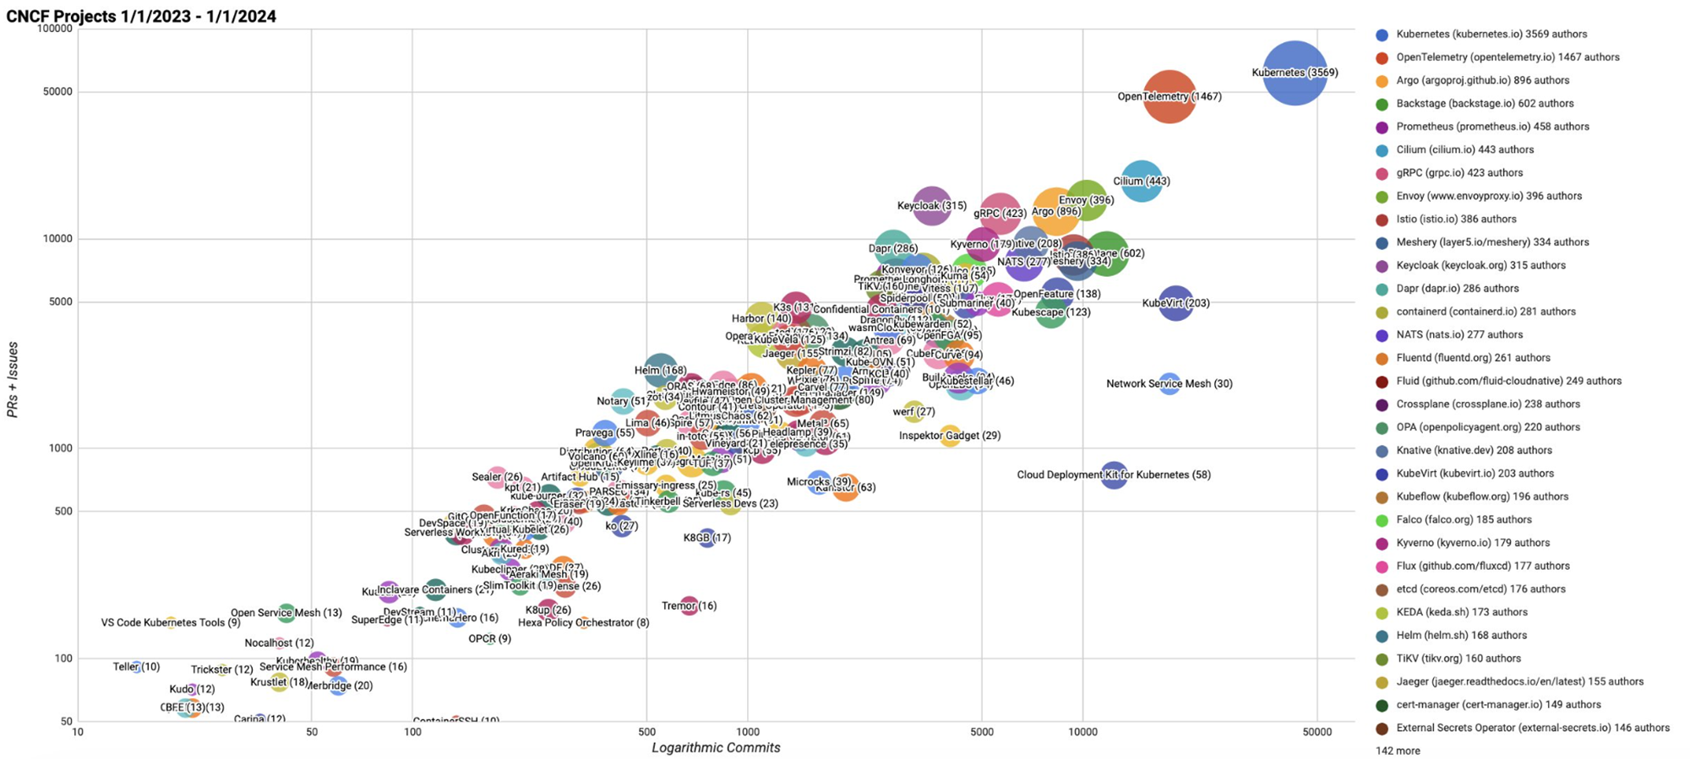
Notes:
Second highest velocity project in CNCF ecosystem
Third highest velocity project in Linux Foundation ecosystem

Slide 8
Notes:
an industry-standard, it is supported by 40+ observability vendors
Its adoption is growing very fast, Gartner predicts that by 2025, 70% of new cloud-native applications will adopt OpenTelemetry for observability - source - https://devops.com/building-an-open-source-observability-platform/

Slide 9

Benefits of OpenTelemetry
Data Portability
Data Flexibility
Tool Convergence
Cost Control
Support for Rust, Swift, Elixir
Notes:
Data portability - Vendor neutral instrumentations
Standard semantic conventions, configurations, APIs, and OLTP protocol
Data flexibility - Send metrics and traces to Datadog, logs to another backend
Send production telemetry to Datadog and Development data to Prometheus
Tool Convergence - Avoid setting up multiple vendor agents on the same hosts
Less time spent on in-house solutions or multiple instrumentation mechanisms
Cost Control - Sampling telemetry data before sending it to the vendor
Reducing the number of agents running in their environment or even completely eliminating them

Slide 10
OpenTelemetry is focused on the generation, collection, management, and export of telemetry.
opentelemetry.io/docs/what-is-opentelemetry

Slide 11
A major goal of OpenTelemetry is that you can easily instrument your applications or systems, no matter their language, infrastructure, or runtime environment.
The storage and visualization of telemetry is intentionally left to other tools.

Slide 12
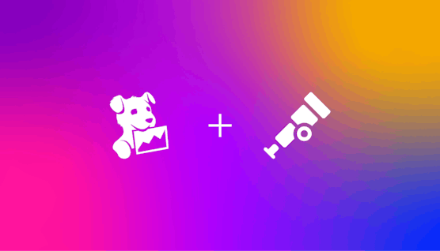
Notes:
Long-standing culture of active support and involvement in open source projects
Contributions to the OTel project
OTel-focused guidance, advice, and technical support
Actively improving native interoperability with OTel for seamless onboarding

Slide 13
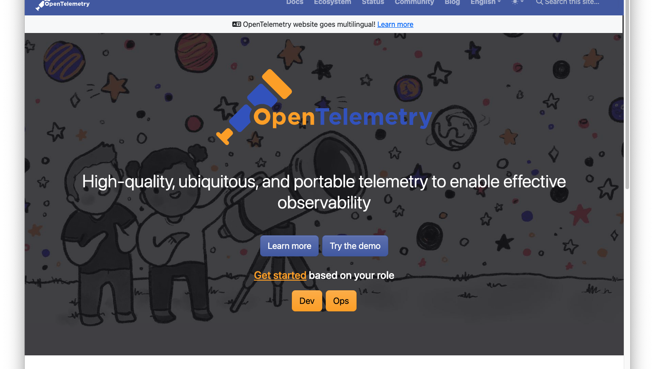
OpenTelemetry
opentelemetry.io/docs/what-is-opentelemetry

Slide 14
Demo: OTEL & .NET Aspire

Slide 15
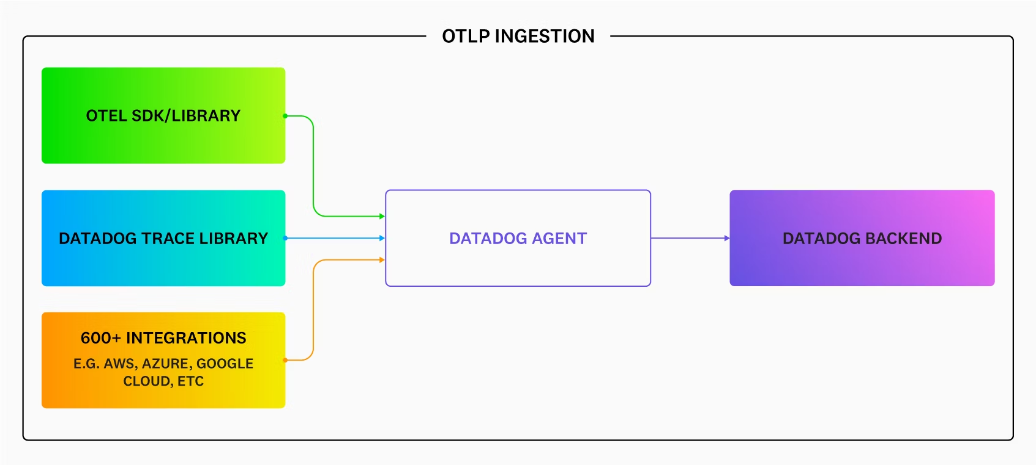
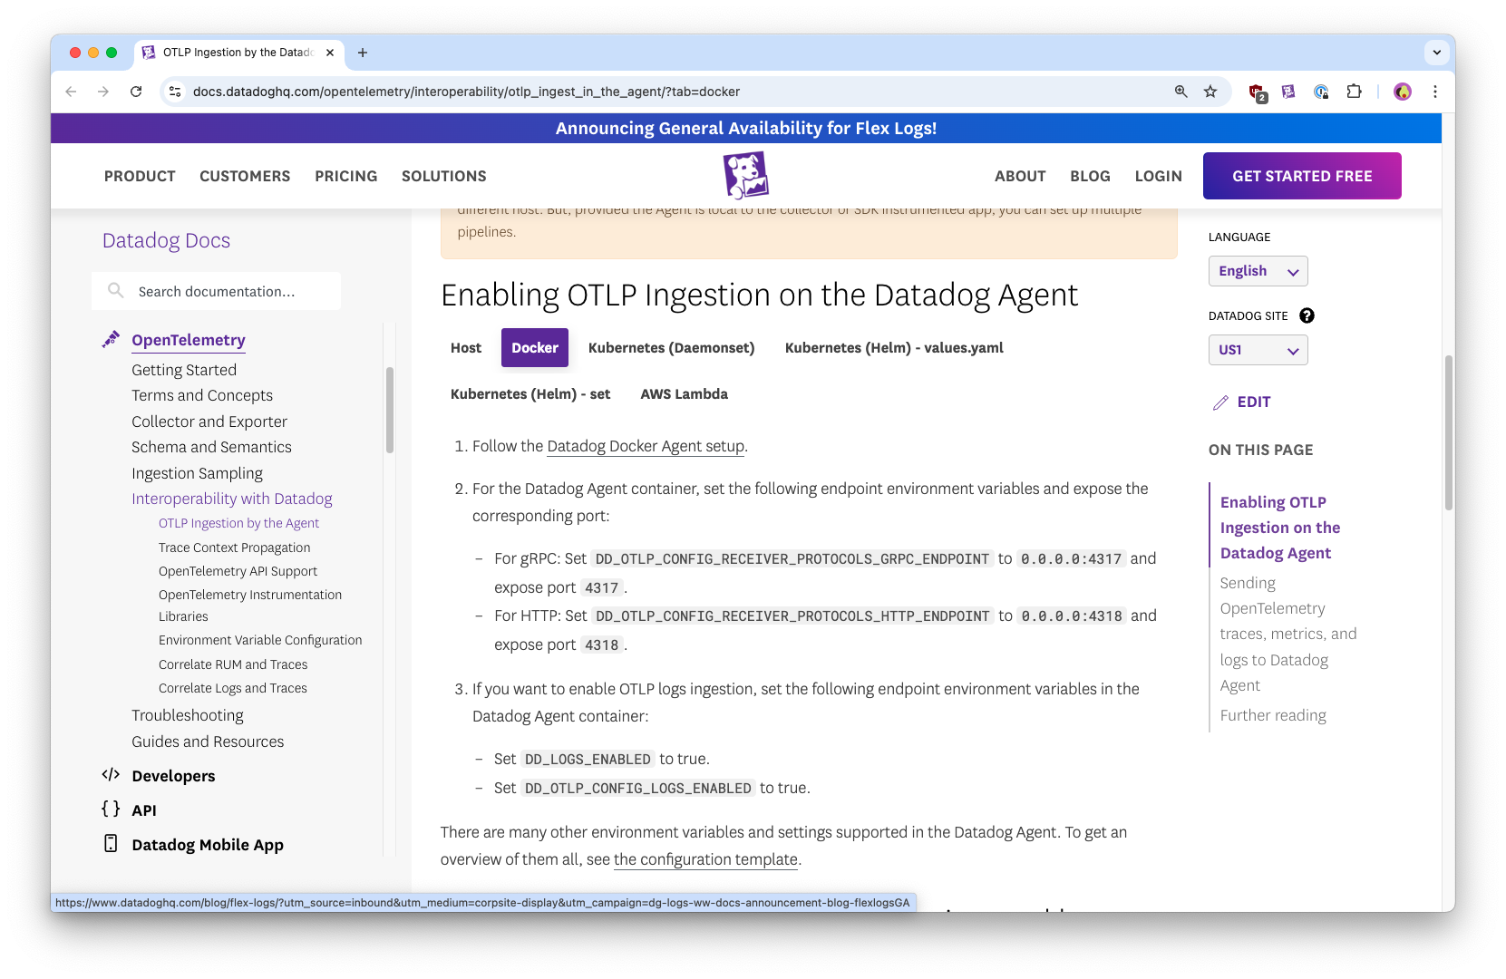
OpenTelemetry in Datadog

Slide 16
OpenTelemetry in Datadog

Slide 17
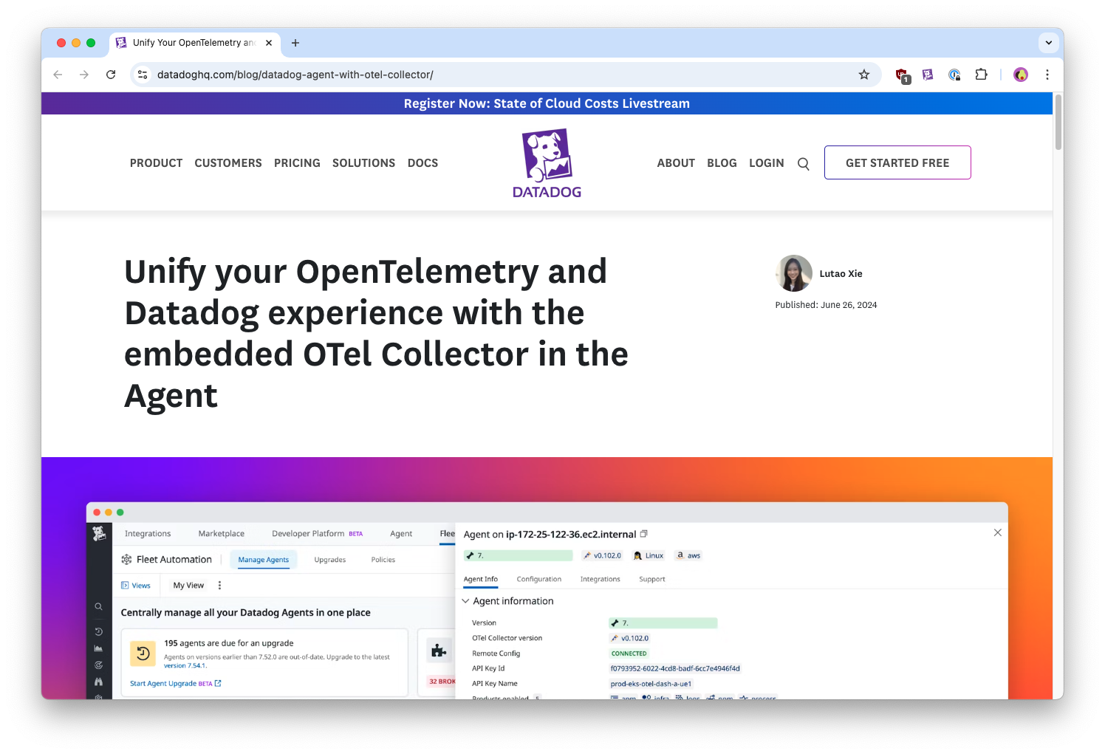
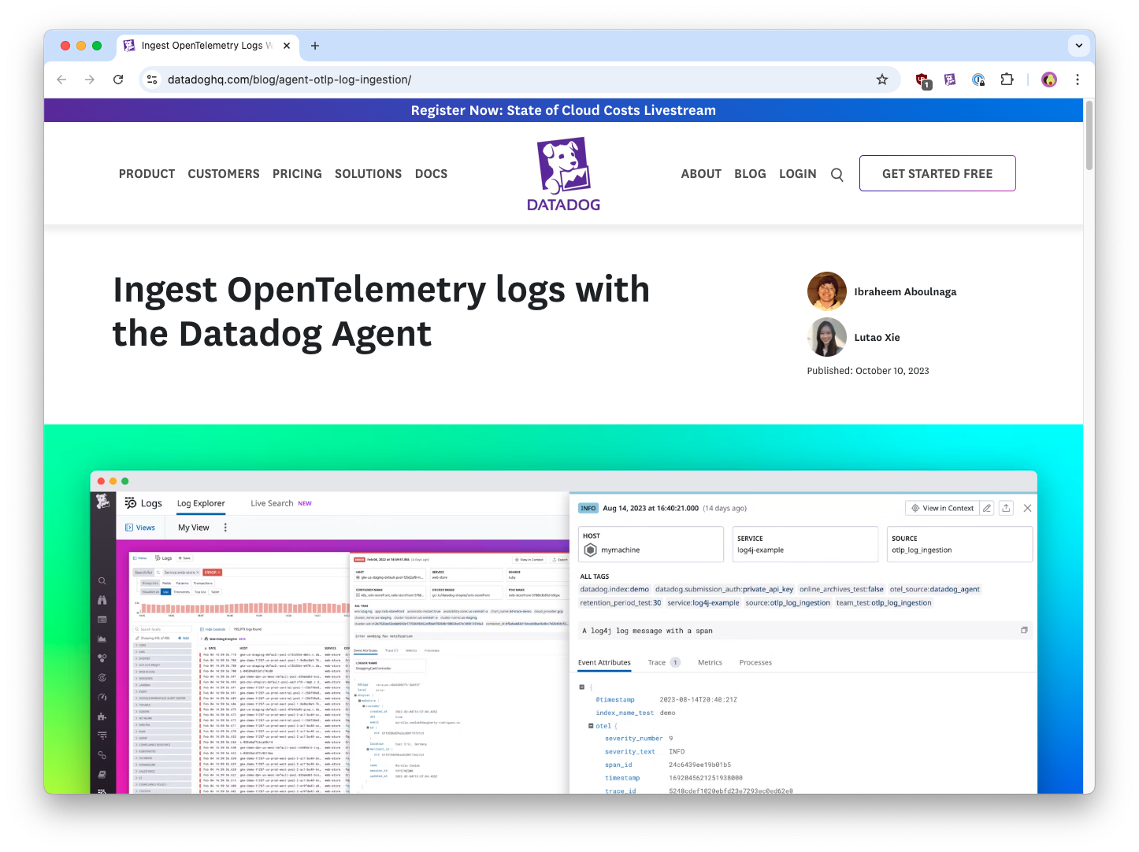
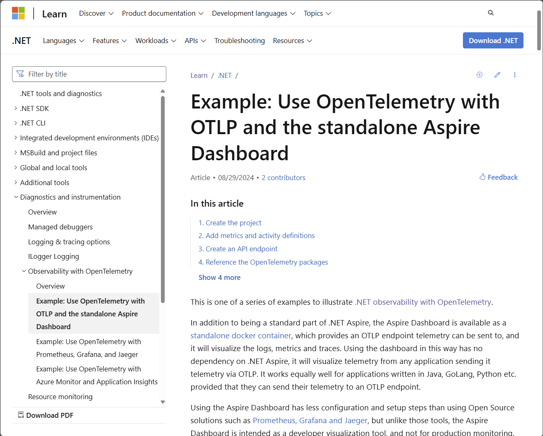
Demo: OpenTelemetry in Datadog

Slide 18
Resources

Slide 19
Resources
learn.datadoghq.com

Slide 20

Get .NET 9
Download .NET 9 aka.ms/get-dotnet-9

Slide 21
Resources
https://github.com/jasonhand/DotNetConf24
https://c5m.ca/otel-demo
GitHub repository (companion content and links)
.NET Aspire & Otel Workshop. Reproduce the session demos.
https://www.youtube.com/watch?v=8i3FaHChh20
Let's Learn .NET Aspire video

Slide 22
Thank you

